Slide 1




Superstore Sales Analysis
Oct 17, 2023
Pinky Bhansali

Slide 2
Content
Objectives
Data Analysis using SQL
1
2
3
4
5
Conclusions
and
Suggestions
About Data and Findings
Important Factors

Slide 3



About Dataset and findings
The case study consist of one dataset
The Superstore dataset provides information/details about sales and profit data for a variety of products sold across different categories and regions.
Dataset consist of 5902 rows and 21 columns post data cleaning.

Slide 4
Objective
Analysing the data from superstore for given period of the time
Publish the finding based on data analysis

Slide 5
Important Factors considered for analysis
Total number of orders
Top 5 customers to place maximum orders
Total orders- Region-wise
Total number of orders based on Shipping Mode
Top 3 months with highest average sales
Bottom 3 months with lowest average sales

Slide 6


Total number of orders
Total number of orders received from Jan 2019 to Dec 2020
2954

Slide 7

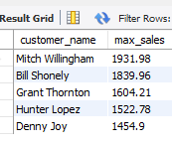
Top 5 customers
List of top 5 customers those who have made high purchases..

Slide 8

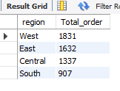
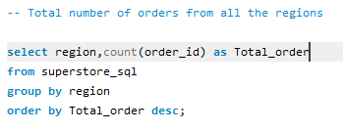
Region wise total number of orders
Highest Number of Orders are received from West Region

Slide 9
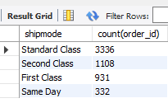
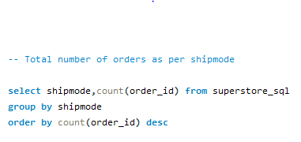
Total number of orders based on shipping Mode
Most orders are shipped via Standard Shipping

Slide 10
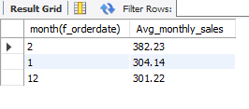
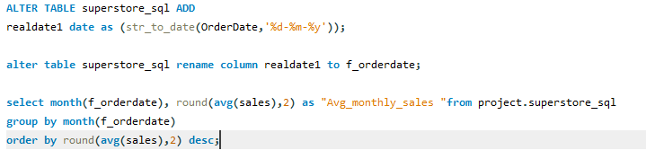
Top 3 months with highest average sales
Highest Sales is recorded in month of February than in Jan and Dec.

Slide 11
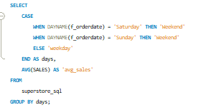
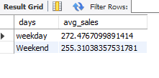
Sales in Weekends
Sales in weekdays is higher as compared to weekends

Slide 12
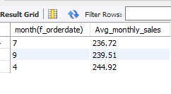

Bottom 3 months with lowest average sales
July, September and April are the months where sales is low

Slide 13
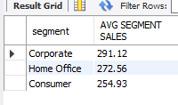

Avg Sales segment wise
As per the data the sales in corporate segment is more than that in Home Office and Consumer

Slide 14
Conclusion:
Total number of orders received from Jan 2019 to Dec 2020 - 2954
Highest Number of Orders are received from West Region
Most orders are shipped via Standard Shipping
Highest Sales is recorded in 3 month of February Jan and Dec.
Sales in weekdays is higher as compared to weekends
July, September and April are the months where sales is low
As per the data the sales in corporate segment is more than that in Home Office and Consumer

Slide 15
Suggestions
Top Customers who had made high purchases can be given some special discounts, store credits , special gift cards or free gifts with their purchase.
Western region has the highest sales compared to other regions; the company could consider increasing its focus on this region and re-evaluate its marketing and sales strategies in other regions.
The company should focus on maximizing the production by increasing the inventory of popular products during the months of February, January and December. They can also run targeted marketing campaigns, offering promotions or discounts to customers. However, the company should also consider strategies to increase sales during other months, by introducing new products or services or offering promotions and discounts during slower months.

Slide 16
Suggestions
The company could consider focusing on different types of promotions or sales strategies during the weekends to increase sales.
For example:
the company could offer weekend-only promotions or discounts or run targeted marketing campaigns
The company could arrange special events or activities in-store on weekends to attract customers and increase sales.
the company could focus on offering products and services that are particularly popular among weekend shoppers, such as home entertainment or outdoor product.
The company can focus on training, maintenance and other recreation activities in low sales month like July, September and April when sales are low. Also can increase the promotions and offer discounts on the products

